Slide 1
Tentative Topic of Project
Presented
by
Dharuv Singla 2210990268
Dhruv Grover 2210990274
Dikshit Singla 2210990284
Under the supervision
Of
Mr.Vikas and Ms.Parul Gehlot
Name of Department/School
Chitkara University, Punjab

Slide 2
Introduction
Introduction regarding the background of the project area/proposed problem
In the ever-evolving realm of financial technology, our project takes center stage as a promising venture – a meticulous replication of the renowned Ticker Tape stock market app. As financial markets become increasingly dynamic, the demand for intuitive and comprehensive stock market platforms has never been more pronounced.
The Ticker Tape stock market app clone seeks to address this demand by recreating the distinctive features and functionalities that users have come to appreciate. In an era where swift access to real-time financial data is paramount, our app strives to provide a seamless and user-friendly experience for investors, traders, and enthusiasts alike.

Slide 3
Motivation of Research
Motivation behind the work
Motivation behind the Ticker Tape Stock Market App Clone:
The motivation behind developing the Ticker Tape stock market app clone stems from a deep-seated commitment to democratize financial information and empower individuals in their investment journey. Here are key motivations driving our work:
Accessibility for All:
Financial markets can be complex and intimidating. The Ticker Tape stock market app clone aims to simplify the access to critical financial data, making it accessible to users across different levels of expertise. By providing a user-friendly interface and replicating Ticker Tape's features, we aim to break down barriers to entry.
Empowering Informed Decisions:
Informed decision-making is at the core of successful investing. Our motivation lies in providing users with the tools and resources needed to make well-informed decisions in the stock market. By replicating Ticker Tape's real-time data integration and analysis features, we strive to empower users to navigate the financial markets with confidence.
Financial Inclusion:
Financial inclusion is a global imperative. Our app clone is motivated by the desire to contribute to financial inclusion by offering a platform that caters to a diverse audience. Whether users are seasoned investors or novices exploring the stock market, our app aims to provide a level playing field for all.

Slide 4
Tools & Technologies
HTML:
The project utilizes HTML (Hypertext Markup Language) as the foundational markup language for creating the structure and content of web pages.
JavaScript:
JavaScript is employed for dynamic and interactive elements within the app. It facilitates real-time updates, user interactions, and seamless integration with the Polygon API.
CSS (Cascading Style Sheets):
CSS is used for styling and layout purposes, ensuring a visually appealing and responsive user interface. It contributes to the overall design and presentation of the app.
Bootstrap:
Bootstrap, a popular front-end framework, is incorporated to enhance the responsiveness and styling of the web pages. It provides a grid system, pre-designed components, and a consistent look and feel across different devices.
Polygon API:
The app integrates the Polygon API to fetch real-time stock market data. This API is a key component, providing access to a wide range of financial information, including stock prices, market trends, and other relevant data.

Slide 5
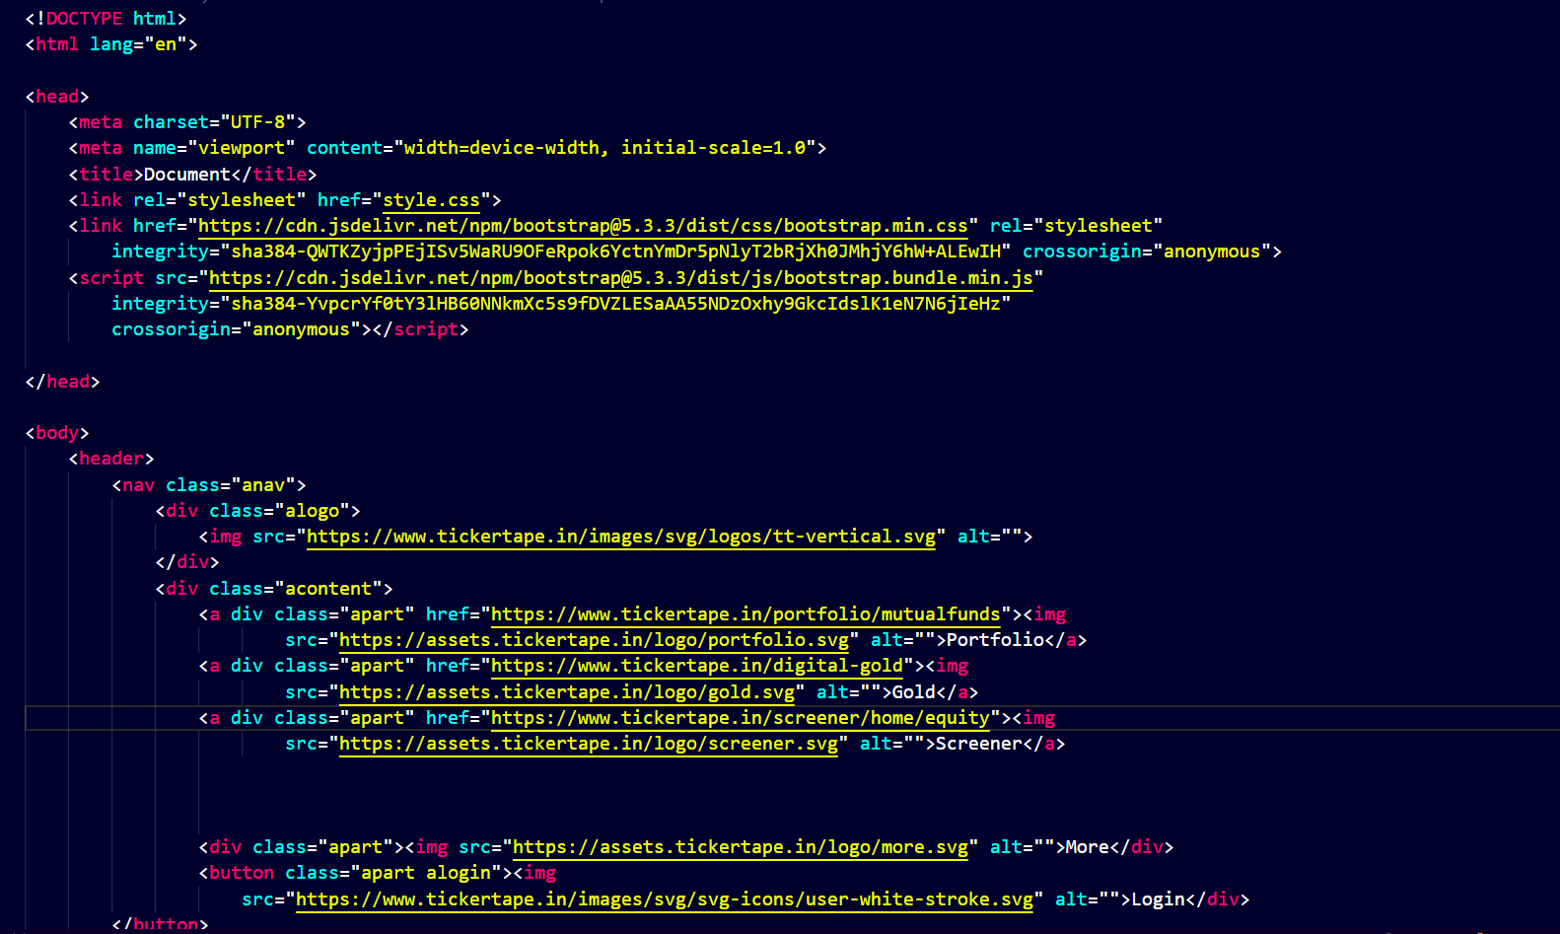
Code Snapshots

Slide 6
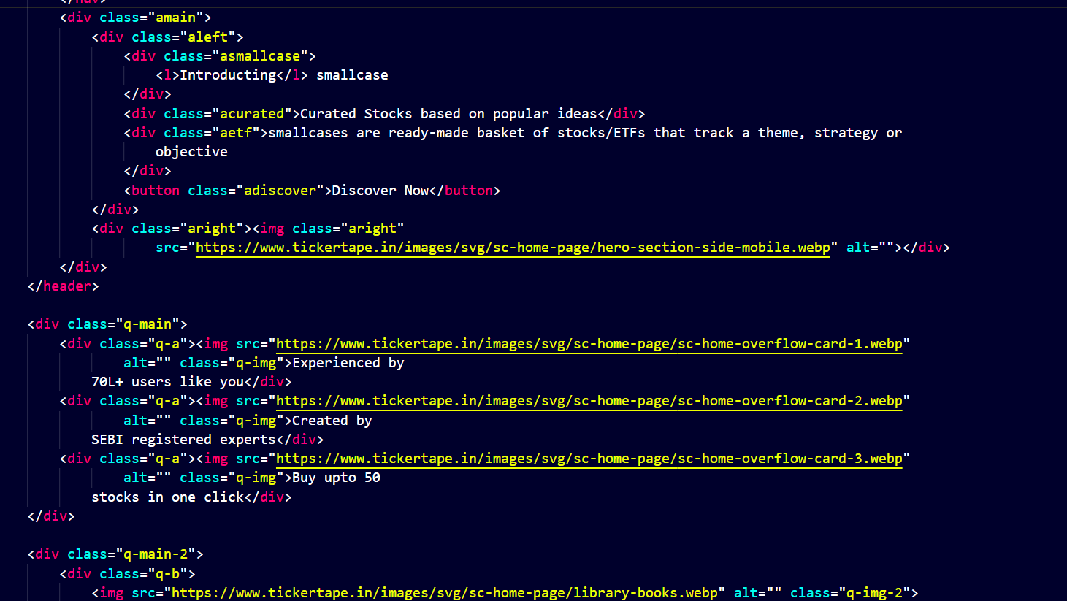

Slide 7
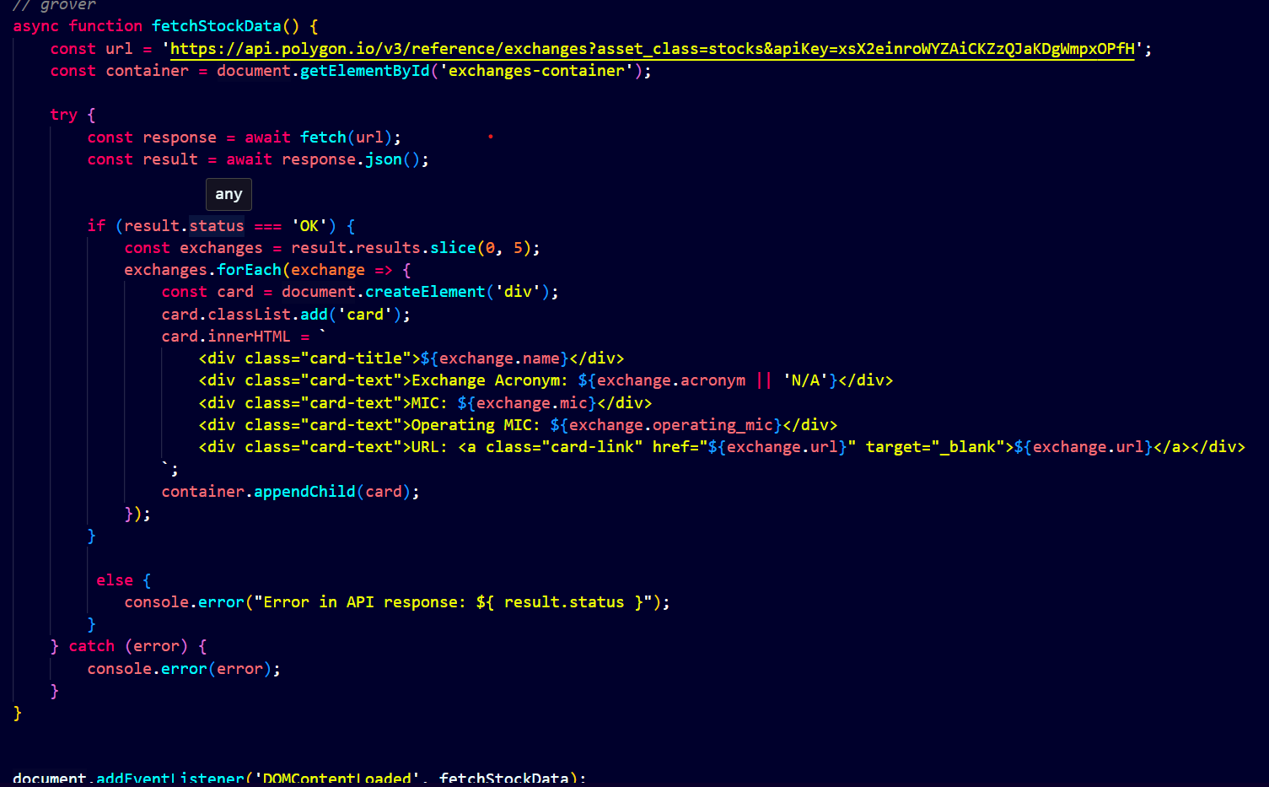

Slide 8
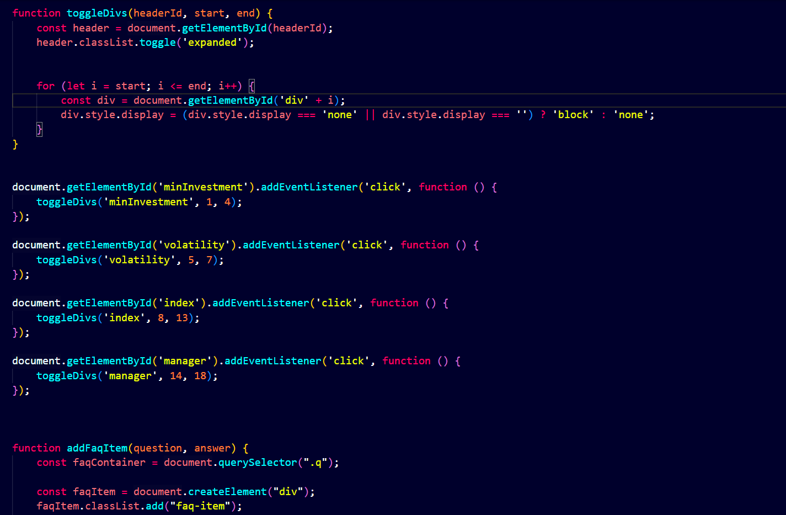

Slide 9
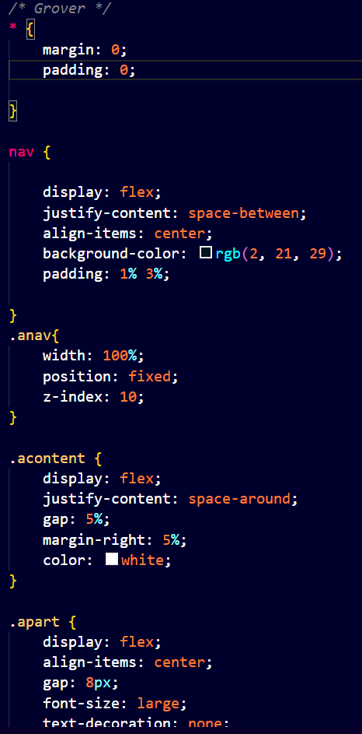
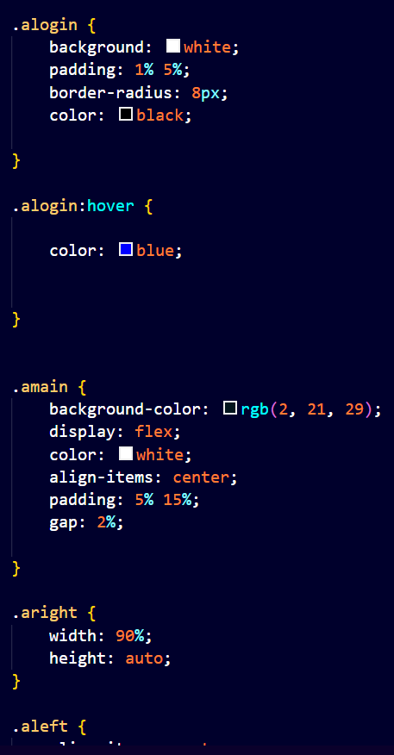
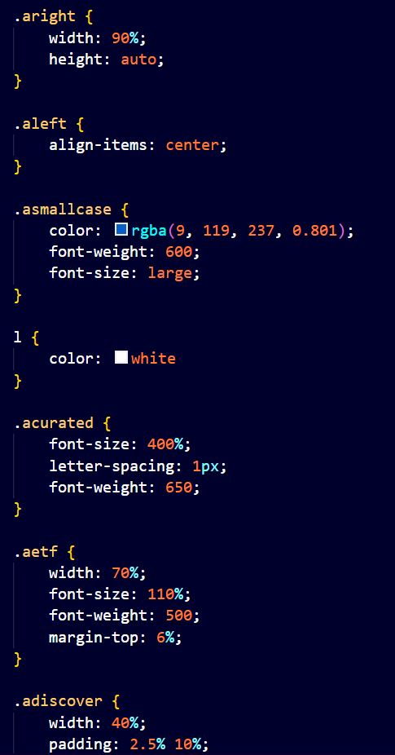

Slide 10
Conclusion/Theme Plan
Conclusion/Theme Plan for the Ticker Tape Stock Market App Clone:
In wrapping up the development of the Ticker Tape Stock Market App Clone, we outline a comprehensive conclusion and a thematic plan for future enhancements:
Conclusion:
The completion of the Ticker Tape Stock Market App Clone marks a significant milestone in our pursuit of democratizing financial information and empowering users in their investment endeavors. The amalgamation of HTML, JavaScript, CSS, Bootstrap, and the Polygon API has resulted in a user-friendly and feature-rich application that mirrors the essence of the original Ticker Tape app.
Through meticulous attention to detail, we have successfully replicated key features, such as real-time data integration, user-friendly navigation, and educational resources. The commitment to accessibility, financial inclusion, and innovation has been at the forefront of our development process.

Slide 11
References
List of key references here for your study
https://chat.openai.com/
https://polygon.io/
https://www.tickertape.in/smallcase
https://getbootstrap.com/

Slide 12
Questions???
What specific features or functionalities are you looking to implement or enhance in your Ticker Tape Stock Market App Clone?
How do you envision user engagement and interaction within your app? Are there any unique elements you'd like to introduce?
Are there specific challenges or roadblocks you've encountered during the development process that you would like assistance with?

